Slide 1
SMS Vending machine
Thomas King

Slide 2
Background

Slide 3
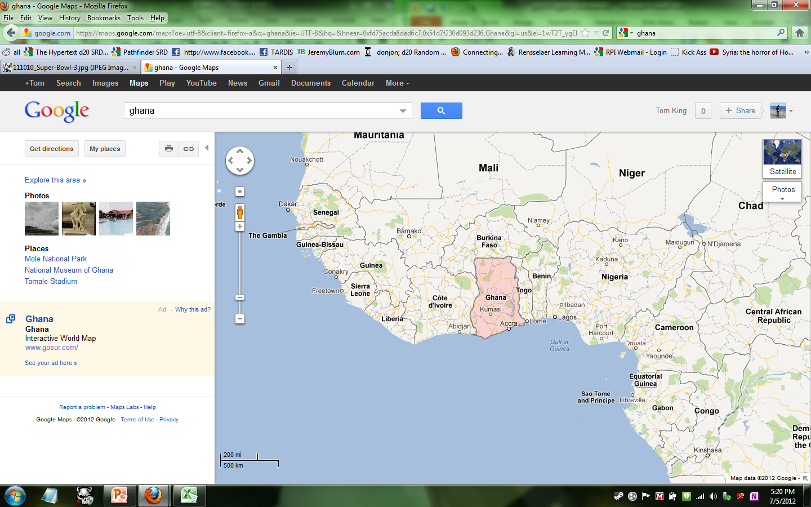

Slide 4
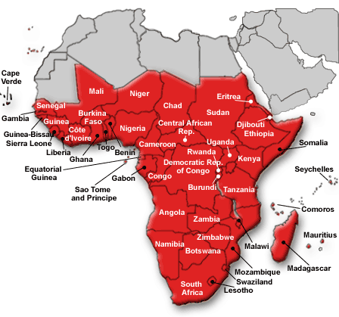

Slide 5
HIV/AIDS
Estimated 34 million Adults and Children in 2010 living with HIV/AIDS
Estimated 22.9 million of those are in the Sub-Saharan African Region
  1.9 million newly infected from 2009-2010 (2.7 million world wide)
  5% adult prevalence (0.8% worldwide)
  1.2 million Aids related deaths (1.8 million worldwide)

Slide 9

Business
Can’t give product away.

Slide 10
Business
Can we make selling easier?
  Automated/ vending machine
Can we involve technology?
  What technology is available?

Slide 11
SMS sending Vending machine
Work off existing cell phone service
Arduino to run everything
GPRS shield
Allow Data collection
Improve refill response time

Slide 12
Goals
Troubleshoot anything that goes wrong.
Work on a new version (more for business)
  More energy efficient
  Better hardware setup
  Wait to send texts until it has service

Slide 13
Thank You!
Sean O’Sullivan
Professor Moorthy
RCOS
Team in Ghana

